Slide 1



SKAPIS
Online Marketplace for Everybody
https://github.com/KuLLuKeNaN/teamETIK-section101-finalproject
PRESENTED BY:
NAME OF THE GROUP :
APPLIED SYSTEM SOFTWARE
Irmak Kürekçi 221ADB194
Elif Çokcan 231ADB021
Tuna Yalcin 221ADB180
Kayra Akel 221ADB169
Efehan Aras 221ADB079
TEAM ETIK
DIP392(English)(1)24/25-P

Slide 2


03 | Project Overview and Motivation
04 | Chosen SDLC Methodology
05 | Requirements Gathering & Analysis
06 | Software Requirements Specification
07 | System and Software Design
08 | Implementation Phase
09 | Testing Strategy
10 | Test Results and Validation
11 | Process Challenges and Lessons Learned
12 | Demo Overview
13 | Conclusion and Future Work
** | Demonstration on Working Prototype
Agenda

Slide 3

03/15
01
Empowering students and small businesses
Project Overview And Motivation
02
Supporting financial independence and entrepreneurial growth
SKAPIS, a second-hand/homemade product marketplace platform designed for Riga
03
Security.
Reliability.
User-friendliness.

Slide 4

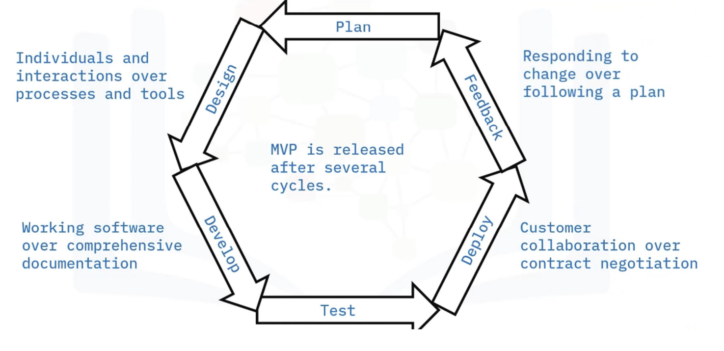
04/15
Chosen SDLC Methodology
What is Agile Method and why did we used it?
Features:
#
Fast Feedback and Collaboration with Client
#
Evolving Requirements
#
Less Overhead, More Progress

Slide 5

05/15
Requirements Gathering & Analysis
KNOWN REQUIREMENTS | CLIENT FEEDBACK
Secure user accounts and login | Trust and safety are top priorities
Product listing system with images, pricing, and categories | Desire for low or no student fees
Advanced search and filters | Need for simple UI and educational content
Verified online payment | Product verification builds platform credibility
Chat and notification features
Admin panel for moderation and analytics
Product controller to verify item condition
Review and rating system
User Types
Sellers: Create shops, list products, message buyers, manage listings
Buyers: Browse/search, message sellers, purchase items, leave reviews

Slide 6

06/15
Software Requirements Specification
Functional Requirements
Non-Functional Requirements
User Stories

Slide 7
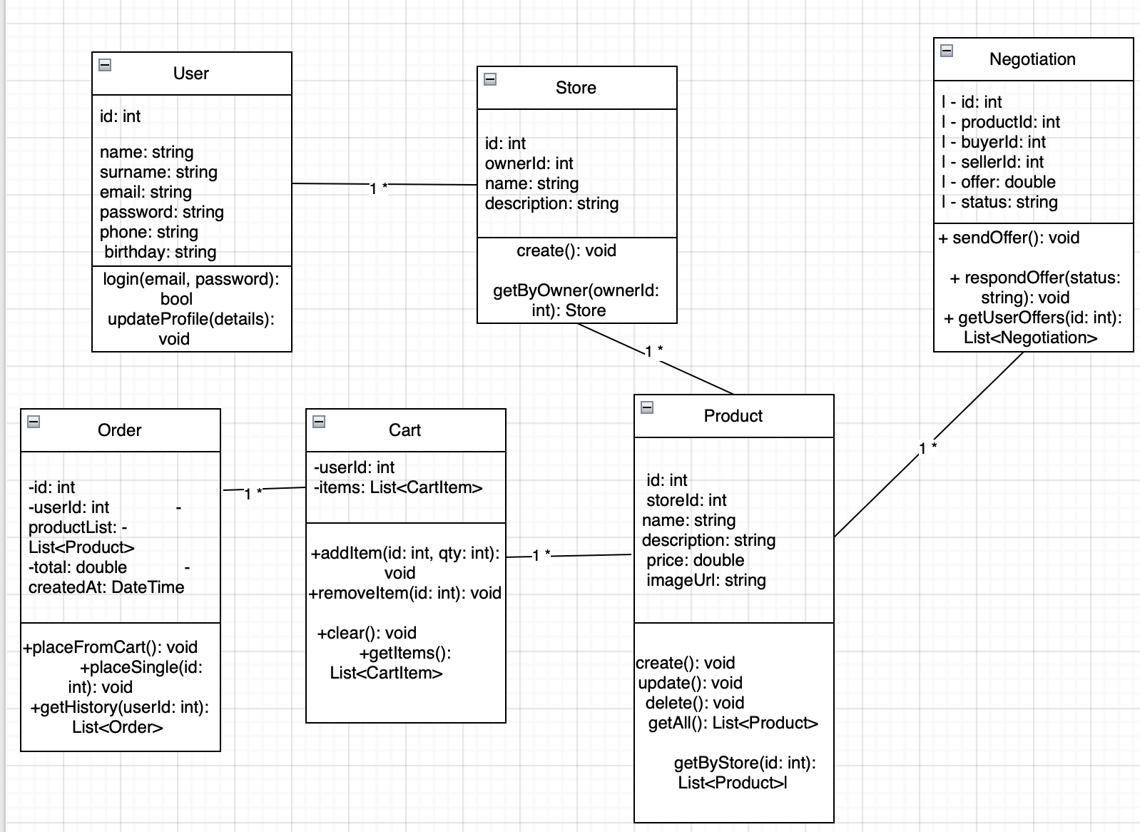

07/15
System and Software Design

Slide 8


Implementation Phase
08/15
Phase 1: Core Programing Concepts
Phase 2: Backend Implementation
Phase 3: Frontend Implementation
Phase 4: Client-Server Integration & Authentication

Slide 9
Testing Strategy
09/15
BLACK-BOX TESTING
Testing Techniques
Test Coverage by Class

Slide 10
Test Results and Validation
10/15
Methodology
All tests done via frontend UI (no internal code inspection)
Simulated real user interactions
All validations matched expected output behavior
Outputs Observed
Success and error messages
Redirects (e.g., after login or checkout)
UI feedback: product lists, cart updates
System behavior under invalid actions
.
Inputs Tested
Form inputs (e.g., login, product creation)
File uploads (product images, 5MB limit)
Button clicks (e.g., place order, send message)
Filters, dropdowns, and search queries

Slide 11
#
Role Flexibility Implementation
Authentication & Token Management
Backend Deployment & API Failures
Data Validation & Security
User Experience Design
Time Management
Personal Issues
11/15
#
#
Process Challenges and Lesson Learned
#
#
#
#

Slide 12
12/15
Demo Overview
Sign In
Sign Up
Create shop
Edit info
Edit billing info
Add product
Buy
Negotiate

Slide 13
14/15
Conclusion and Future Work

Slide 14
THANK YOU!
.

